Slide 1
NAND3 Example P14
CpE 213
WS 2001

Slide 2
Software NAND3 in C
Sbit defines a bit variable
Reg51.h defines values of P1 and other 8051 regs
Line 12 makes port bits inputs
While(1) is infinite loop
Zout is complement of and of all 3 inputs (nand3)
4 #include <reg51.h>
6 sbit A1=P1^4;
7 sbit B1=P1^5;
8 sbit C1=P1^6;
9 sbit Zout=P1^7;
10
11 void main(void){
12 1 A1=B1=C1=1;
13 1 while(1) {
14 2 Zout= ~(A1 & B1 & C1);
15 2 }
16 1 }

Slide 3
Compiled C code (ASM)
Fields: addr/code/source
?C0001: is a label or symbolic address (=6)
Compare to code in text
This is relocatable code
Address 0000 is just first address of this module
This is actually location 0003
0000 D296 SETB C1
0002 D295 SETB B1
0004 D294 SETB A1
0006 ?C0001:
0006 A295 MOV C,B1
0008 8294 ANL C,A1
000A 8296 ANL C,C1
000C B3 CPL C
000D 9297 MOV Zout,C
000F 80F5 SJMP ?C0001
0011 22 RET
Address
Code

Slide 4
Hex Object File
:10 0003 00 D296D295D294A29582948296B3929780 F7
:02 0013 00 F522 D4
:03 0000 00 020015 E6
:0C 0015 00 787FE4F6D8FD758107020003 37
:00 0000 01 FF
All data is in hexadecimal
First field is length of data (10h is 16 bytes)
Second field is the address of the data in memory
Third field is a record type
Last field is a checksum and rest is data
Compare data to object code in listing
0000 D296 SETB C1
0002 D295 SETB B1
0004 D294 SETB A1
0006 A295 MOV C,B1

Slide 5
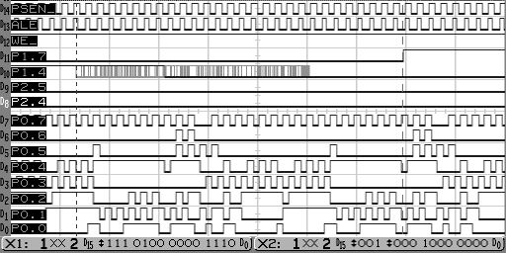
Instruction execution timing
28 ALE’s (168 clocks)
Notes:
This is an actual scope screen shot of P14 running on an XS40 board.

Slide 6
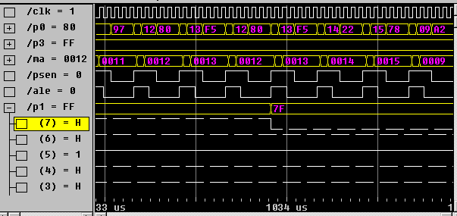
Simulator timing

Slide 7

MPG of running program
P14.C while running
Trigger set to P1.7 rising edge
Note variable arrival time of P1.4 edge

Slide 8
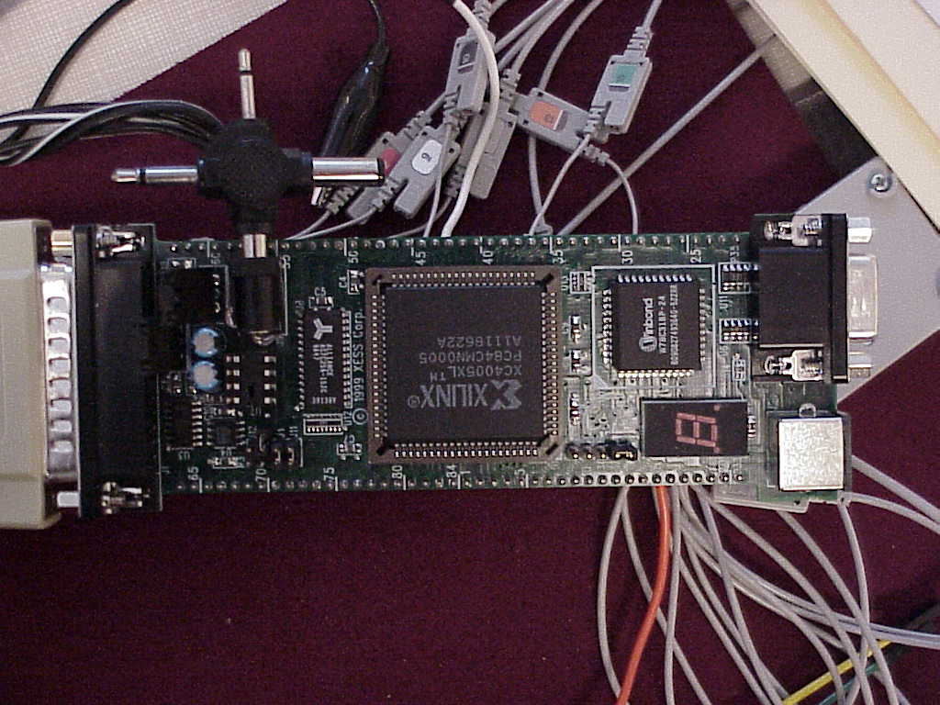
XS40 board
This is a lot harder than simulation! (about 10x)
Not every signal is even visible

